Slide 1
A general non-Newtonian n-body problem and dynamical scenarios of solutions.
Naohito Chino
Faculty of Psychological & Physical Science,
Aichi Gakuin University
Handout presented at the 42 annual meeting of the Behaviormetric Society of Japan.
Tohoku University
September 3

Slide 2
今日の発表内容の構成
１．近年の複雑ネットワーク研究の急激な増加と問題点
２．我々のモデルー非ニュートン的多体問題とその特徴
a) 成員を埋め込む空間の次元圧縮
b) 状態空間の仮定ー複素ヒルベルト空間、不定計量空間
あるいは 2p 次元実空間
c) 統計的時系列解析と力学系理論を用いた解析
d) 変容過程の各種シナリオの予測や系の制御可能性
e) カオスや 1/ f ^{γ} ゆらぎ現象の出現
３．各種シナリオについてのシミュレーション結果の呈示
４．残された課題

Slide 3
Introduction
Formation of group structures and their changes over time are ubiquitous in nature through interactions among constituent members. These members can be celestial bodies, nations, humans, animals, neurons, cells, electrons, and so on.
Two major theories which deal with such a phenomena may be dynamical system theory and graph theory.

Slide 4
Although the theory of dynamical systems is said to go back to the pioneering work of Henri Poincaré in the late 19th century (e.g., Bhatia & Szegö, 1970), the studies on dynamical system may be said to have begun in ancient Babylonia (e.g., Alexander, 1994) and elsewhere.
By contrast, graph theory is said to go back to the work of Euler in the early 18th century (e.g., Harary, 1969).

Slide 5
Recently, there has been increasing atten-tion paid to the study of complex networks in the social and natural sciences, essentially based on graph theory, since the appear-ance of the works of Watts and Strogatz (1998) and Barabási and Albert (1999).
（註１） Watts-Strogatz (1998) は、Nature 論文
（註２） Barabási-Albert (1999) は、Science 論文
（註３） Academic Search Premier & PsycInfo を用いて、
‘complex networks’ を検索すると、

Slide 6
1991 (22篇), 2002 (208篇), 2009 (1036篇),
2013 (1492篇) と、 2001 年までは 100篇未満
であるが、2002 年からは 100 篇台に、2009 年
からは 1000 篇台へと、矢久保 (2013)も指摘
しているように、 2000 年代初等から爆発的に
論文数が増えている。
On the one hand, Watts and Strogatz (1998) proposed the small-world model which is characterized by the property that two nodes can be connected with a path of a few links

Slide 7
only (Barabási & Oltvai, 2004). Here, nodes (vertices) and paths (edges) are usually as- sumed in graph theory, and these corres-pond to members and interactions between members, respectively.
path
(edge)
node
(vertex)

Slide 8
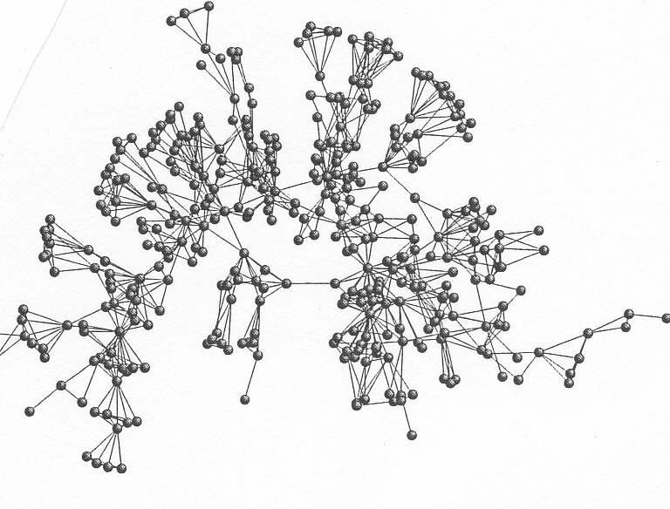
（註１） 次の図は、Newman, M. E. J. (2006). Phys. Rev. E, 74,
のネットワーク科学の分野の比較的小さな (N=2,742) 共著関
係ネットワークの一部であり、最大連結部分を抜き出したもの
（矢久保, 2013, p.144） の一つを切り出したものである。

Slide 9
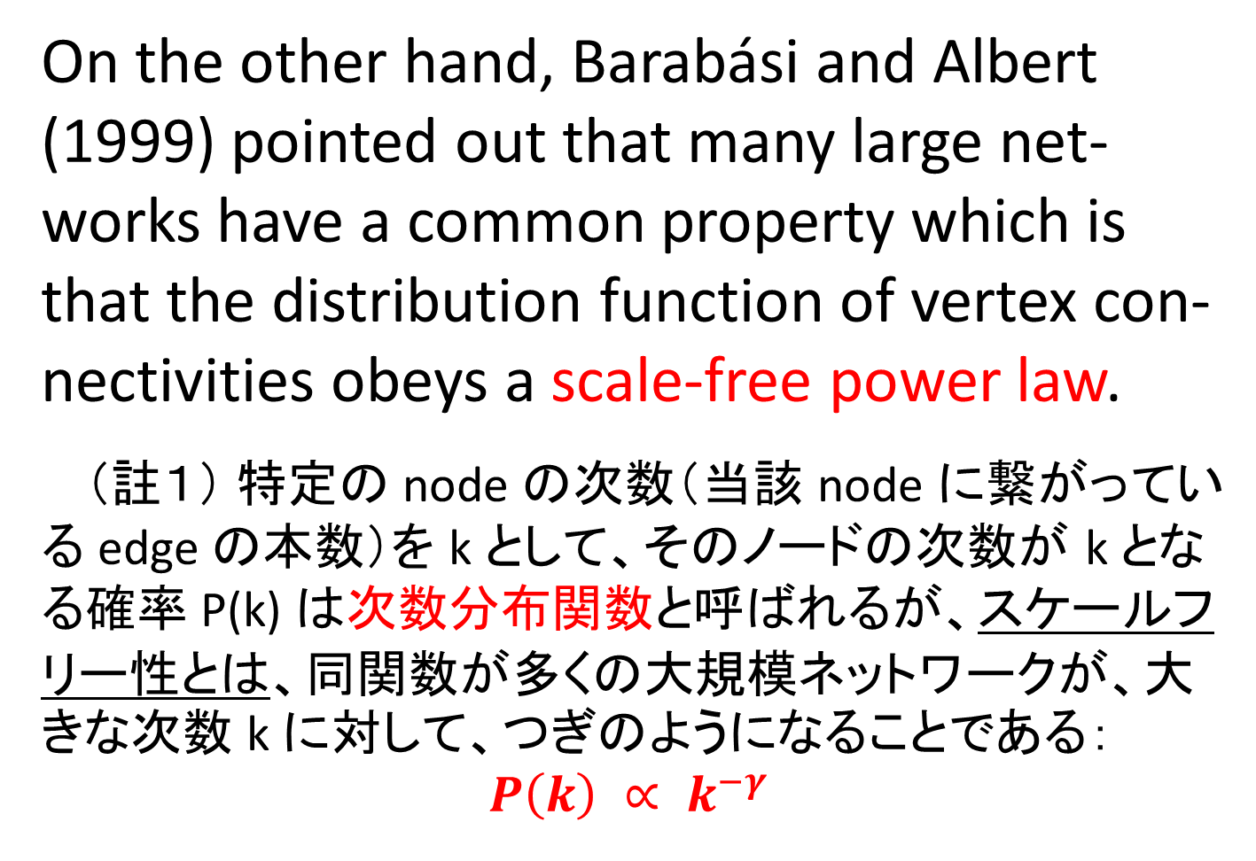
On the other hand, Barabási and Albert (1999) pointed out that many large net-works have a common property which is that the distribution function of vertex con-nectivities obeys a scale-free power law.
（註１） 特定の node の次数（当該 node に繋がっている edge の本数）を k として、そのノードの次数が k となる確率 P(k) は次数分布関数と呼ばれるが、スケールフリー性とは、同関数が多くの大規模ネットワークが、大きな次数 k に対して、つぎのようになることである：
$$P\left(k\right) ∝ k^{−γ}$$

Slide 10
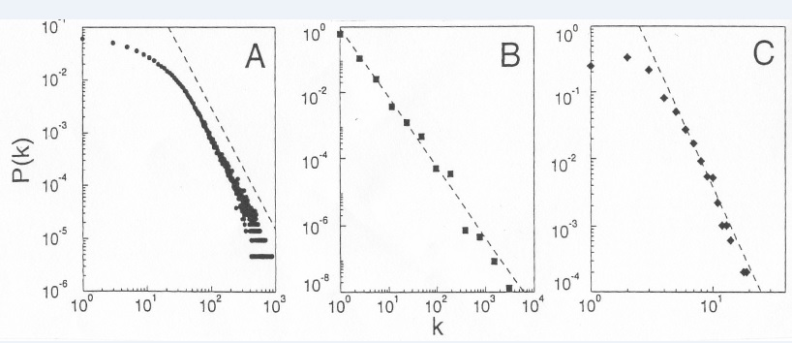
（註２）次の図は、Barabási and Albert (1999). Science,
286, の Fig. 1 を切り取ったものである。A の俳優共演
関係のネットワークで ノード数 N=212,250, B は WWW
で N=325,729, C は送電線ネットワークで N=4,941 である。これらの図の log-log スケール上での点線の傾き γ は、順に 2.3, 2.1, 4.0 である。

Slide 11
Although these quantifiable tools of
complex networks have provided various
possibilities to understand group structure
and its evolution, there seems to be a fun-
damental shortfall in these tools, which is
inherited from graph theory. That is, in
graph theory the existence or nonexistence
of each path is binary.

Slide 12
However, strengths of interactions bet-
ween members of group in the actual sys-
tem are thought of as continuous and vary
in time. Considering this point, an alterna-
tive theory, i.e., dynamical system theory,
seems to be more promising.
（註） もちろん、グラフ理論でも重み付き有向グラフ (weighted digraph) の各 edge の重みを相互作用の大きさとみなすことはできる。

Slide 13
In ecological networks, especially in food-
web there have been a body of literature
which utilize dynamical system theory in
modelling change in predator-prey rela-
tionship over time. Some of them use non-
linear difference equation model, while
others nonlinear differential equation mod-
el (e.g., Chesson & Warner, 1981; Chesson &
Warner, 1981; Lotoka, 1910, 1925; McCann

Slide 14
et al., 1998; Voltera, 1926).
For example, MaCann et al. (1998) pro-
posed an interesting nonlinear differential
equation model as a food-web model, in
which they considered food-webs compos-
ed of three or four species, one being the
top predetor, another being a resource
species, the other being one or two con-
sumer species. They examined the effects

Slide 15
of relative interaction strengths on change
in densities of species over time. Results
indicated that chaotic behaviors occur
when the interaction strengths as bifurca-
tion parameters of the system vary as time
proceeds（註：これも Nature 論文）.
Chesson and Warner (1981) proposed a
lottery model which is described by a set of
nonlinear difference equations. This model

Slide 16
explains a certain coexistence phenome-
non of species.
However, these models discussed above
merely deal with change in numbers or
density of species. In other words, the
number of dimensions of the state spaces
of these models is equal to the number of
species. The same is true for the neural

Slide 17
network models (Amari, 1972; Aihara et al.,
1990). Moreover, most of the network
models discussed up to now assume that
the state space of the system is real, except
for the complex neural network models
(i.e., Aizenberg et al., 1971, 2000; Hirose,
1992; Suksmote et al., 2005).
In this paper, we propose a revised ver-
sion of the complex difference equation

Slide 18
model proposed by Chino (2000, 2002,
2006). In section 2 we shall discuss the
necessity for distinguishing a real diffe-
rence system model from a complex diffe-
rence system model, using the notion of
differentiability of the difference equation
under consideration. In section 3 we shall
point out that our difference equation
model can be interpreted as a non-Newton-

Slide 19

ian n-body problem, and that some curi-
out results such as $f^{−ν}$-type noise can be seen from a small simulation study of our model.

Slide 20
Real vs. complex difference system model
Until recently we have called our diffe-
rence equation model the `complex diffe-
rence system model' (2000, 2002, 2006).
This model is defined as follows:

Slide 21
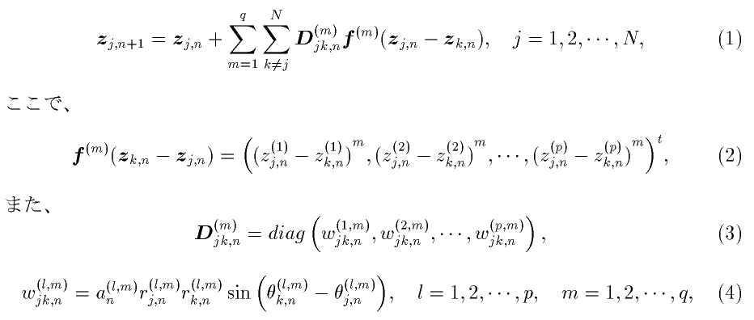
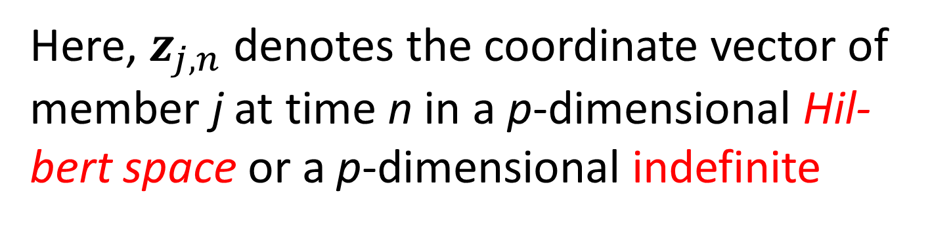
Here, $z_{j,n}$ denotes the coordinate vector of
member j at time n in a p-dimensional Hil-
bert space or a p-dimensional indefinite

Slide 22
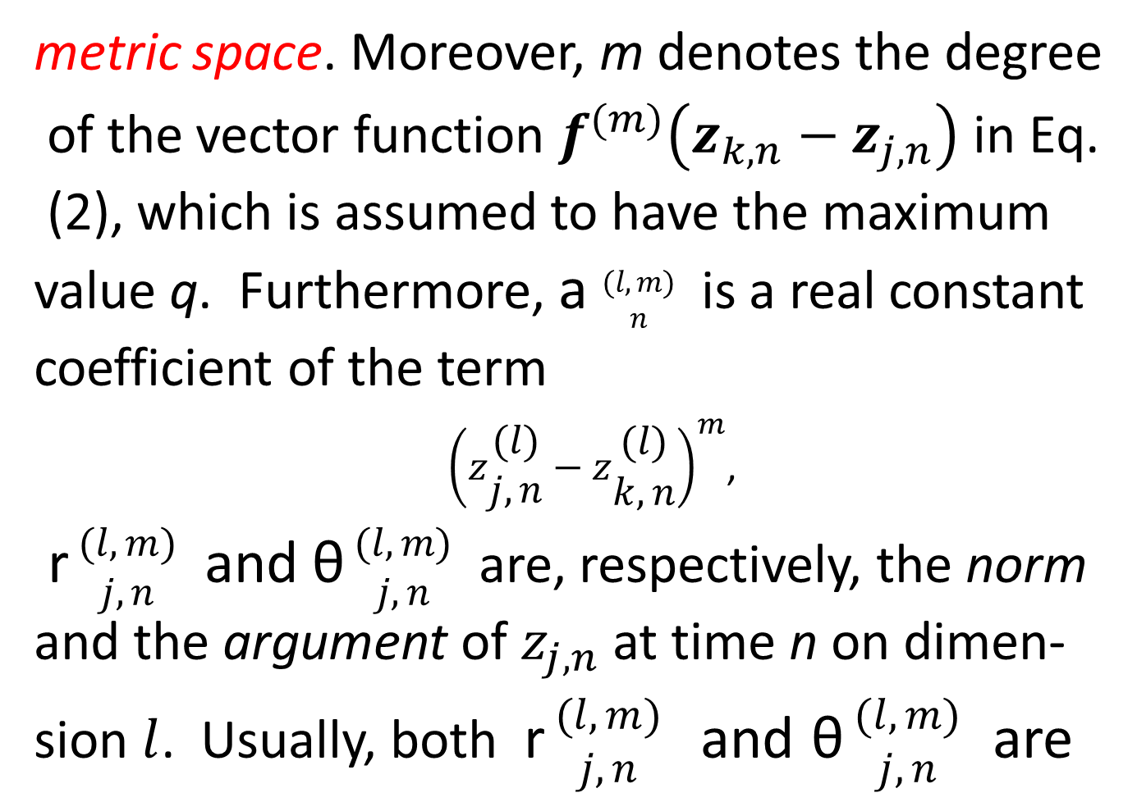
metric space. Moreover, m denotes the degree
of the vector function $f^{(m)}\left(z_{k,n}−z_{j,n}\right)$ in Eq.
(2), which is assumed to have the maximum
value q. Furthermore, a $\begin{matrix}(l,m) \\ n\end{matrix}$ is a real constant
coefficient of the term
${\left(z\begin{matrix}(l) \\ j,n\end{matrix}−z\begin{matrix}(l) \\ k,n\end{matrix}\right)}^{m}$,
r $\begin{matrix}(l,m) \\ j,n\end{matrix}$ and θ $\begin{matrix}(l,m) \\ j,n\end{matrix}$ are, respectively, the norm and the argument of $z_{j,n}$ at time n on dimen-
sion $l$. Usually, both r $\begin{matrix}(l,m) \\ j,n\end{matrix}$ and θ $\begin{matrix}(l,m) \\ j,n\end{matrix}$ are

Slide 23
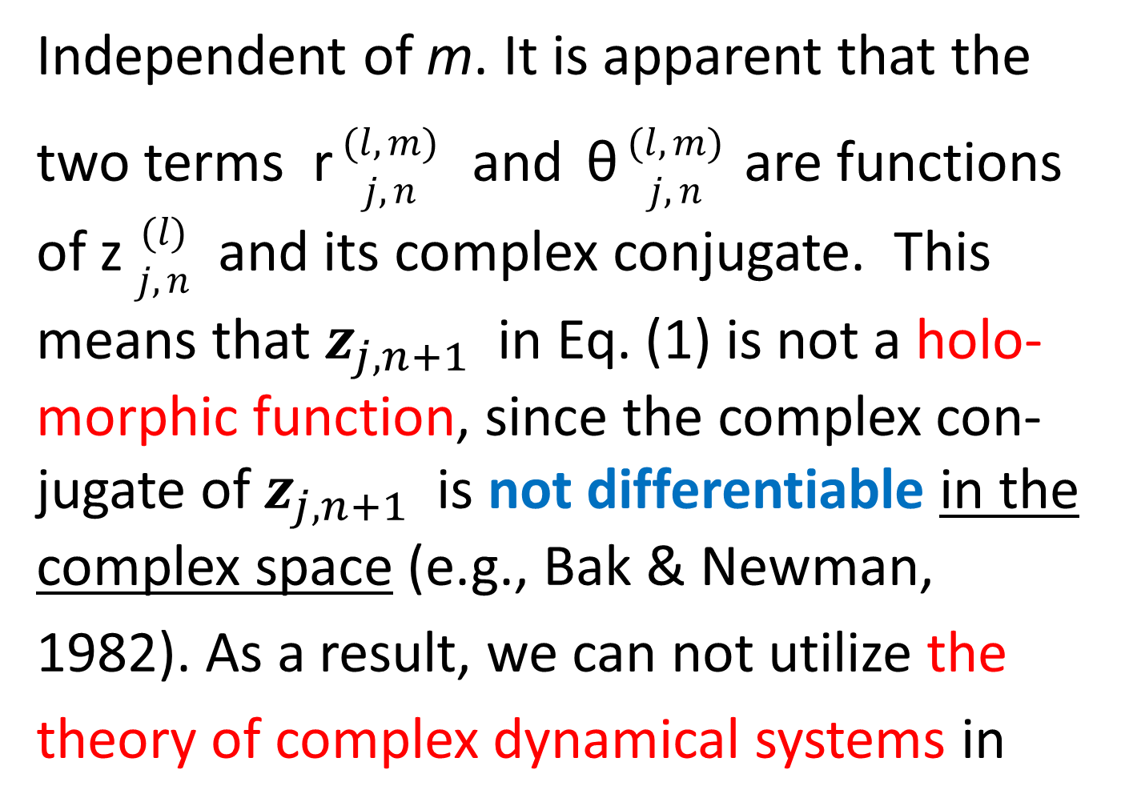
Independent of m. It is apparent that the two terms r $\begin{matrix}(l,m) \\ j,n\end{matrix}$ and θ $\begin{matrix}(l,m) \\ j,n\end{matrix}$ are functions of z $\begin{matrix}(l) \\ j,n\end{matrix}$ and its complex conjugate. This means that $z_{j, n+1}$ in Eq. (1) is not a holo-morphic function, since the complex con-jugate of $z_{j, n+1}$ is not differentiable in the complex space (e.g., Bak & Newman,
1982). As a result, we can not utilize the
theory of complex dynamical systems in

Slide 24
mathematics, as far as we assume Eq (4).
Of course, if we assume Eq. (4) and if we
identify the state space of our complex
difference system as 2p-dimensional real
space, we need not drop Eq. (4). However,
we have recently dropped it, in order to
utilize the theory. Furthermore, we have
made a new assumption that weights,

Slide 25
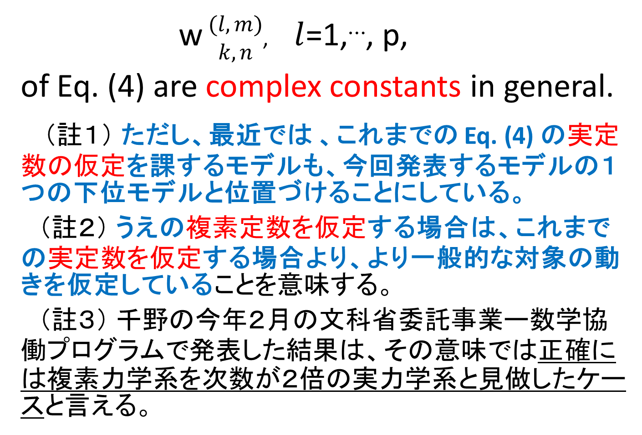
w $\begin{matrix}(l,m) \\ k,n\end{matrix}$, $l$=1,⋯, p,
of Eq. (4) are complex constants in general.
（註１） ただし、最近では 、これまでの Eq. (4) の実定数の仮定を課するモデルも、今回発表するモデルの１つの下位モデルと位置づけることにしている。
（註２） うえの複素定数を仮定する場合は、これまでの実定数を仮定する場合より、より一般的な対象の動きを仮定していることを意味する。
（註３） 千野の今年２月の文科省委託事業ー数学協働プログラムで発表した結果は、その意味では正確には複素力学系を次数が２倍の実力学系と見做したケースと言える。

Slide 26
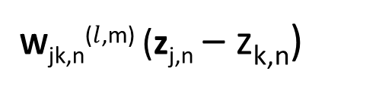

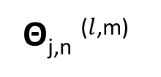
モデル上の対象の動き
最も単純な一次モデルの例 ($dim. l$=1, deg. m=1)
imaginary
W_{jk,n}⁽$l$^{,m)} (z_{j,n} – z_{k,n})
Z_{k,n}
positive
direction
Z_{k,n+1}
of HFM
Θ_{j,n} ⁽$l$^{,m)}
Z_{j,n}
Z_{j,n+1}
real

Slide 27
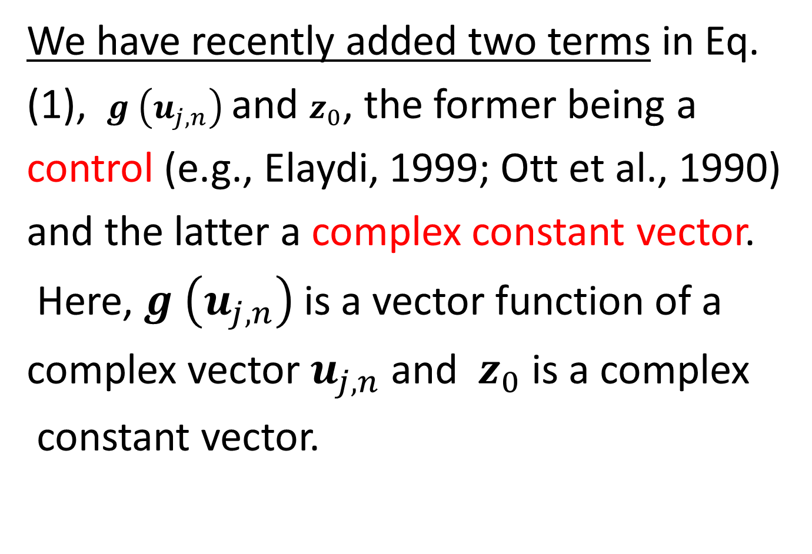
We have recently added two terms in Eq.
(1), $g$ $\left(u_{j,n}\right)$ and $z_{0}$, the former being a
control (e.g., Elaydi, 1999; Ott et al., 1990)
and the latter a complex constant vector.
Here, $g$ $\left(u_{j,n}\right)$is a vector function of a
complex vector $u_{j,n}$ and $z_{0}$ is a complex
constant vector.

Slide 28
３ A non-Newtonian n-body problem
As discussed in the introductory section,
number of dimensions of the state spaces
in complex networks is equal to the num-
ber of members. In these network models,
if the number of members increases, the
number of dimensions becomes enormous.
In order to avoid this, we utilize the Chino-
Shiraiwa theorem in psychometrics (Chino

Slide 29
& Shiraiwa, 1993). It enables us to reduce
the number of dimensions in complex net-
works drastically, depending on the manner
of interactions in these networks.
This theorem also teaches us the nature
of the space in which we embed members.
If we can observe a real relationship matrix
whose element is composed of the intensity
of interactions among members at some

Slide 30
instant in time, we can estimate the num-
ber of dimensions using this theorem. The
space may either be the complex Hilbert
space or the indefinite metric space, accor-
ding to the theory. As a result, the prob-
lem given in the beginning of the Introduc-
tory section can be thought of as a general
non-Newtonian n-body problem in some
finite-dimensional complex space, in which

Slide 31
interactions are generally asymmetric.
We have recently proven that even a
dyadic relation model, which is a special
case of the new models in the revised
version, includes a Mandelbrot set as a
special case (e.g., Mandelbrot, 1977).
Furthermore, we have recently found that
even a special triadic relation model some-

Slide 32
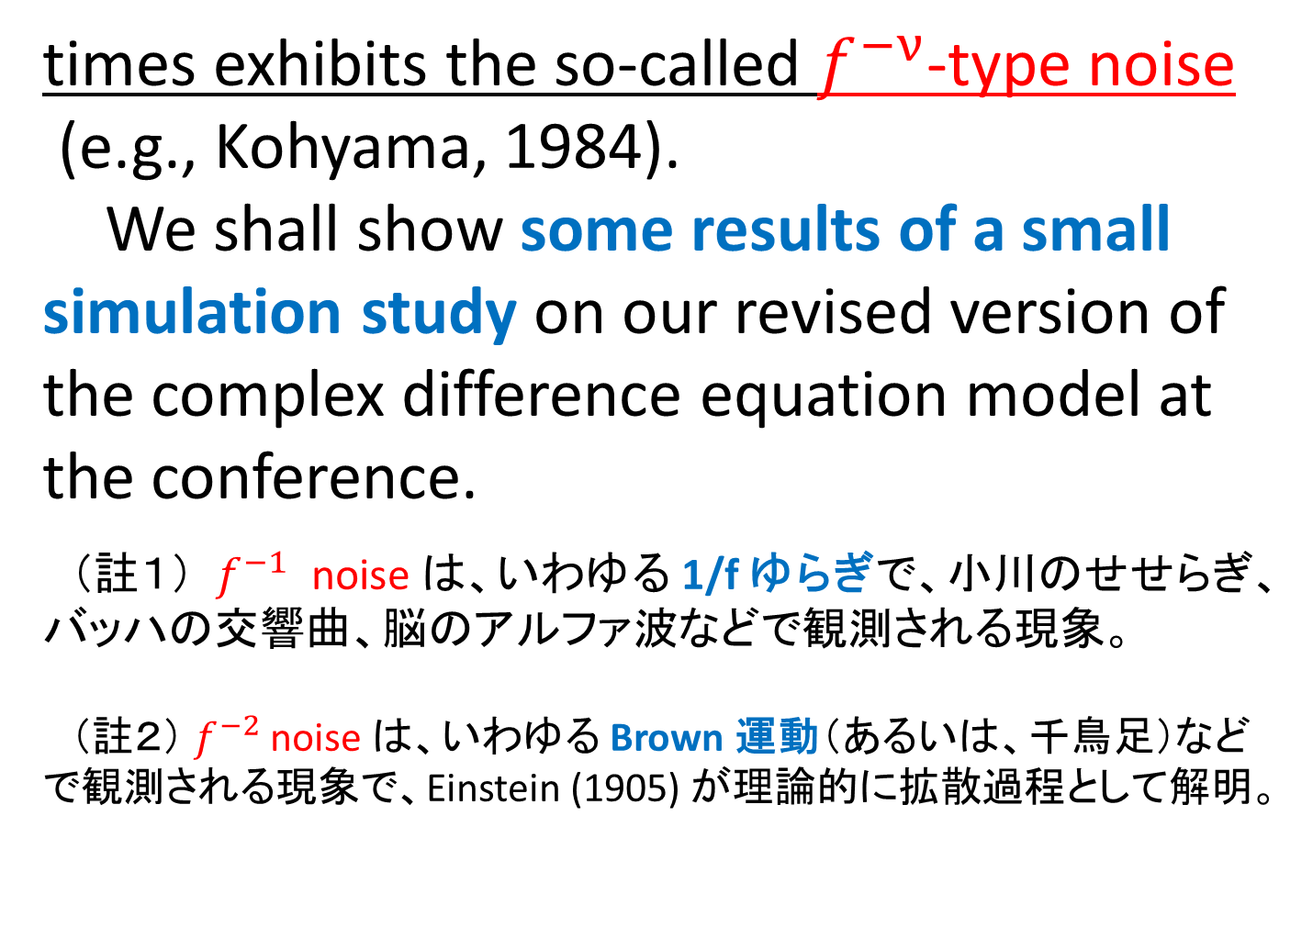
times exhibits the so-called $f^{−ν}$-type noise
(e.g., Kohyama, 1984).
We shall show some results of a small
simulation study on our revised version of
the complex difference equation model at
the conference.
（註１） $f^{−1}$ noise は、いわゆる 1/f ゆらぎで、小川のせせらぎ、
バッハの交響曲、脳のアルファ波などで観測される現象。
（註２） $f^{−2}$ noise は、いわゆる Brown 運動（あるいは、千鳥足）など
で観測される現象で、Einstein (1905) が理論的に拡散過程として解明。

Slide 33
４．A small simulation study
（１） 2p 次元実空間上の差分力学系のシナリオ
chino, N. (2014). 数学協働プログラム発表補
足資料（千野研究室 HP, 学会発表・講演資
料） (in English).
（２） 複素ヒルベルト空間上の同力学系のシナ
リオ （系のパワースペクトルや非定常性含む）
MATLAB プログラム（実演） .

Slide 34
残された課題
１）時系列データと見た場合の定常性の有無の検討
Page (1952), Priestley (1965) 以来、非定常スペクト
ル等に関する多くの研究あり。
２）系の最大リアプノフ指数の検討ーカオスの検討
３）系の同期 (synchronization）問題や、系の制
御の問題への応用可能性
とりわけ系の同期現象については、１９８０年
代、９０年代に多くの理論的進展がみられる。
４）モデルの実データへの適用

Slide 35
追加引用文献
Chino, N. (2014). A Hilbert state space model for the formation
and dissolution of affinities among members in informal groups.
Supplement of the paper presented at the workshop on The
Problem Solving through the Applications of Mathematics to
Human Behaviors by the aid of The Ministry of Education, Cul-
ture, Sports, Science and Technology in Japan (pp.1-24).
Einstein, von A. (1905). Über die von der molekularkinetishen
Theorie der Wärme geforderte Bewegung von in ruhenden
Flüssigkeiten suspendierten Teilchen. Annalen der Physik, 18,
549-560.
Newman, M. E. J. (2006). Finding community structure in net-

Slide 36
works using the eigenvectors of matrices. Physical Review, E,
036104.
Page, C. H. (1952). Instantaneous power spectra. Journal of Ap-
plied Physics, 23, 103.
Priestley, M. B. (1965). Evolutionary spectra and nonstationary
process. Journal of the Royal Statistical Society B, 27, 204-
237.
矢久保考介 (2013). 複雑ネットワークとその構造 共立出版

